Slide 1
ECE314 Lab 9 Overview
Binary Hypothesis Testing
Sequential Hypothesis Testing
Gambler’s Ruin

Slide 2



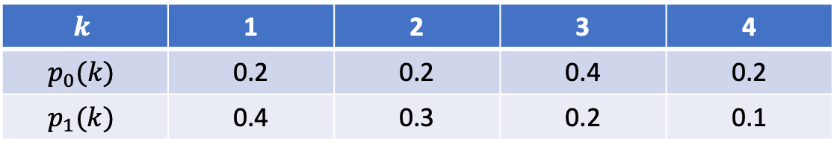
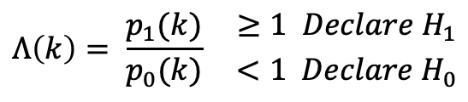

Binary Hypothesis Testing: one observation
$$k$$ | 1 | 2 | 3 | 4
$$p_{0}(k)$$ | 0.2 | 0.2 | 0.4 | 0.2
$$p_{1}(k)$$ | 0.4 | 0.3 | 0.2 | 0.1
$$H_{0}$$
$$H_{1}$$
Goal: Given one observation $k∈\{1,2,3,4\}$. Decide which hypothesis is true.
Likelihood ratio test:
$$Λ\left(k\right)= \frac{p_{1}(k)}{p_{0}(k)} {≥1 Declare H_{1} \atop <1 Declare H_{0}}$$
$$P\left(false alarm\right)=P(declare H_{1}|H_{0})$$
$$P\left(miss\right)=P(declare H_{0}|H_{1})$$

Slide 3
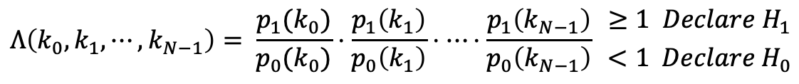
Binary Hypothesis Testing: multiple observations
$$k$$ | 1 | 2 | 3 | 4
$$p_{0}(k)$$ | 0.2 | 0.2 | 0.4 | 0.2
$$p_{1}(k)$$ | 0.4 | 0.3 | 0.2 | 0.1
$$H_{0}$$
$$H_{1}$$
Goal: Given $N$ independent observations $k_{0}, k_{1}, ⋯, k_{N−1}$. Decide which hypothesis is true.
Likelihood ratio test:
$$Λ\left(k_{0},k_{1},⋯, k_{N−1}\right)= \frac{p_{1}(k_{0})}{p_{0}(k_{0})}⋅\frac{p_{1}\left(k_{1}\right)}{p_{0}\left(k_{1}\right)}⋅⋯⋅\frac{p_{1}\left(k_{N−1}\right)}{p_{0}\left(k_{N−1}\right)} {≥1 Declare H_{1} \atop <1 Declare H_{0}}$$
$$P\left(false alarm\right)=P(declare H_{1}|H_{0})$$
$$P\left(miss\right)=P(declare H_{0}|H_{1})$$

Slide 4




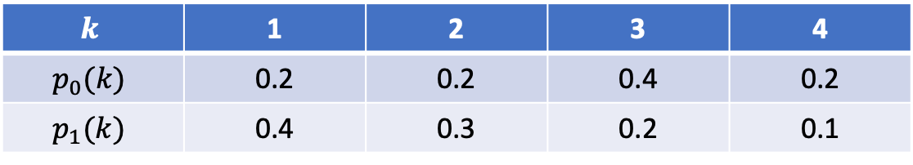
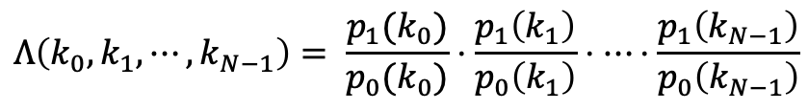



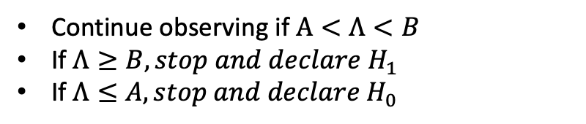
Sequential Hypothesis Testing
$$k$$ | 1 | 2 | 3 | 4
$$p_{0}(k)$$ | 0.2 | 0.2 | 0.4 | 0.2
$$p_{1}(k)$$ | 0.4 | 0.3 | 0.2 | 0.1
$$H_{0}$$
$$H_{1}$$
The number of observations $N$ is not pre-determined and fixed, but is a variable.
Goal: Design a test such that $𝔼N$ is reduced while meeting targeted $p_{fa}$ and $p_{m}$.
$$Λ\left(k_{0},k_{1},⋯, k_{N−1}\right)= \frac{p_{1}(k_{0})}{p_{0}(k_{0})}⋅\frac{p_{1}\left(k_{1}\right)}{p_{0}\left(k_{1}\right)}⋅⋯⋅\frac{p_{1}\left(k_{N−1}\right)}{p_{0}\left(k_{N−1}\right)}$$
$$Λ$$
Sequential probability ratio test (SPRT):
B
Continue observing if $A<Λ<B$
If $Λ≥B, stop and declare H_{1}$
If $Λ≤A, stop and declare H_{0}$
$$1$$
A
$$0$$
$$N$$

Slide 5



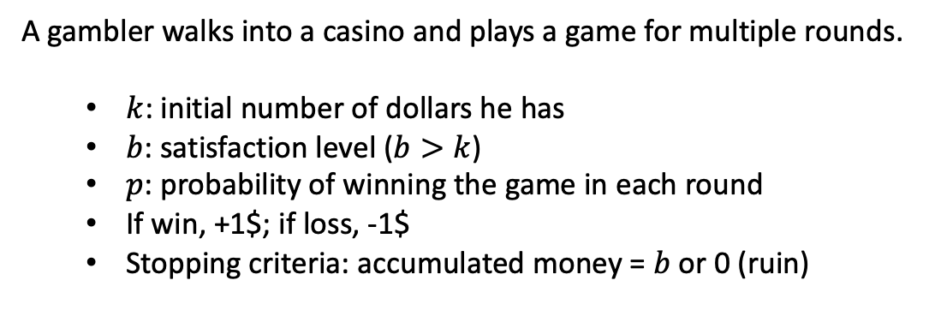

Gambler’s Ruin
A gambler walks into a casino and plays a game for multiple rounds.
$k$: initial number of dollars he has
$b$: satisfaction level ($b>k$)
$p$: probability of winning the game in each round
If win, +1$; if loss, -1$
Stopping criteria: accumulated money = $b$ or 0 (ruin)
$$\$$$
$$b=20$$
$$k=15$$
Question: P(ruin) ?
$$0$$
ruined

Slide 6
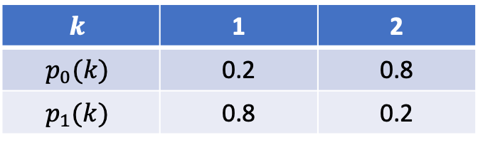


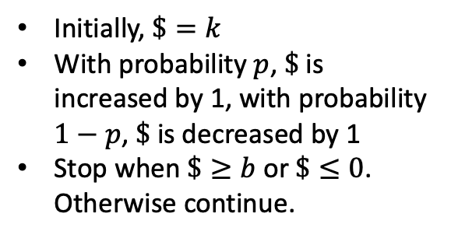


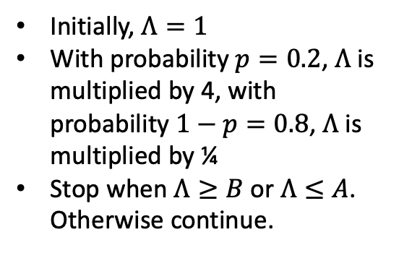



$$k$$ | 1 | 2
$$p_{0}(k)$$ | 0.2 | 0.8
$$p_{1}(k)$$ | 0.8 | 0.2
SPRT vs. Gambler’s Ruin
$$H_{0}$$
$$Λ$$
$$H_{1}$$
B
Initially, $Λ=1$
With probability $p=0.2$, $Λ$ is multiplied by 4, with probability $1−p=0.8$, $Λ$ is multiplied by ¼
Stop when $Λ≥B$or $Λ≤A$. Otherwise continue.
$$1$$
SPRT
A
$$\$$$
$$b$$
Initially, $\$=k$
With probability $p$, $\$$ is increased by 1, with probability $1−p$, $\$$ is decreased by 1
Stop when $\$≥b$or $\$≤0$. Otherwise continue.
$$k$$
Gambler’s Ruin
$$0$$

